Slide 1



Portfolio
HEART DISEASE CLASSIFICATION USING ML ALGORITHM
K Nearest Neighbor, Decision Tree, XGBoost, & Logistic Regression
-
Bhima Fairul Rifqi
Hendri Agustono

Slide 2

Portfolio
Home
About
Content
Others
What is heart disease?
Heart disease is an acquired or congenital abnormality of the cardiovascular system that can be structural, infective, degenerative, inflammatory and often genetic.
Gordon, S. G., & Kittleson, M. D., 2008

Slide 3

Portfolio
Home
About
Content
Others
ML Classification Models
Methodology
In machine learning, classification assigns specific instances or objects to an already-defined category (Kornyo et al, 2023).
Data Cleaning - Data Analysis - ML Classification Models

Slide 4

Portfolio
Home
About
Content
Others
About The
Tools & Library
Library List
Pandas
Numpy
Sklearn
Seaborn
Os
Google Colab

Slide 5
Portfolio
Home
About
Content
Others
About The Dataset
Heart Disease
Dataset
This dataset dates from 19888 and consist of four databases: Cleveland, Hungary, Switzerland, and Long Beach V. It contains 76 attributes, including the predicted attribute, but all published experiments refer to using a subset of 14 of them.
Health
Kaggle

Slide 6
Portfolio
Home
About
Content
Others
14 Attributes Information
Age
Sex ( 0 = female, 1 = male )
Chest Pain Type ( 0 = typical angina, 1 = atypical angina, 2 = non-anginal pain, 3 = asymptomatic )
Trestbps ( Resting blood pressure [ mm Hg ] )
Chol ( Serum cholestrol [mm/dl]
Fbs ( Fasting blood sugar > 120mg/dl (0 = false, 1 = true))
Restecg ( Resting electrocardiographic results (0 = normal, 1 = ST-T abnormal, 2 = Portable criteria) )
Thalach ( Maimum heart rate achieved )
Exang ( Exercise induced angina (0 = no, 1 = yes)
Oldpeak ( ST depression induced by exercise relative to rest )
Slope ( The slope of the peak exercise ST segment (1 = upsloping, 2 = flat, 3 = downloping) )
Ca ( Number of major vessels colored by flourosopy )
Thal ( 3 = normal, 6 = fixed defect, 7 = reversable defect )
Target ( 0 = Less chance of heart attach, 1 = more chance of heart attack )

Slide 7
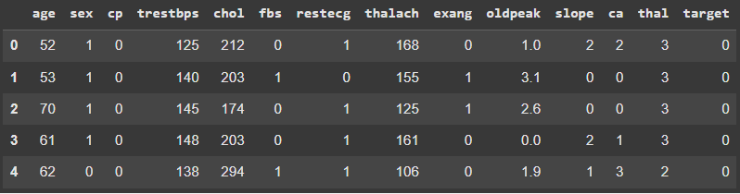
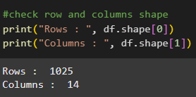


Portfolio
Home
About
Content
Others
Data Cleaning
df.head(5)
Data Overview
print("Duplicate rows : ", df.duplicated().sum())
df = df.drop_duplicates()

Slide 8
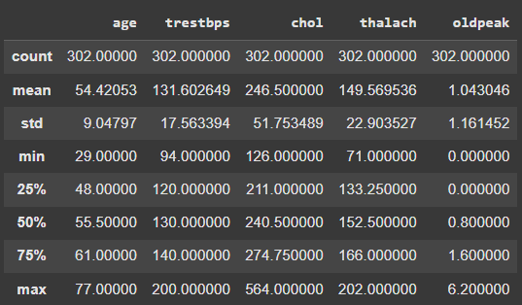
Portfolio
Home
About
Content
Others
Data Analysis: Descriptive Statistics
df[['age','trestbps', 'chol', 'thalach’]].describe()
We selected numerical ratio data that can be analyzed using descriptive statistics, then obtained 302 rows of data and can be seen that the average attribute age is 54 years, then trestbps ranges at 131.60 mmhg, chol at 246.5mm/dl, and thalach at 149.56bpm.
We also can see the youngest observatioin age is 29 and the oldest observation is at 77.

Slide 9
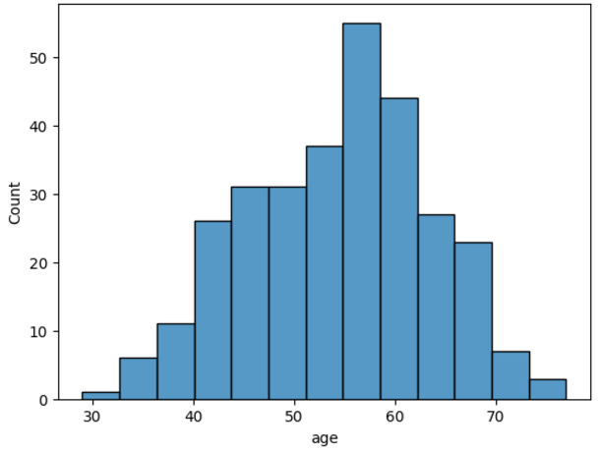
Portfolio
Home
About
Content
Others
Data Analysis: Age Distribution
sns.histplot(df['age'])
It can be seen from the histogram on the side, the highest age attribute distribution is at 55-60 years, then the lowest age distribution is in the age range of 29-30s.

Slide 10
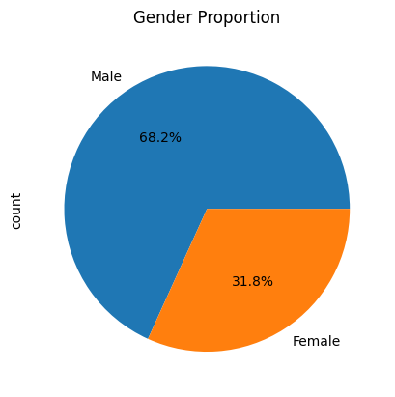
Portfolio
Home
About
Content
Others
Data Analysis: Patient Proportions by Gender
labels = 'Male', 'Female'
df['sex'].value_counts().plot(kind='pie', autopct='%1.1f%%', labels=labels, title='Gender Proportion')
Interpratation:
Based on the pie chart beside, it can be seen that 68.2% of the patients are male, and 31.8% are female.

Slide 11
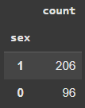
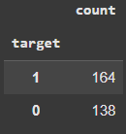
Portfolio
Home
About
Content
Others
Data Analysis: By Gender Analysis
# Gender proportion
labels = 'Male', 'Female'
df['sex'].value_counts().plot(kind='pie', autopct='%1.1f%%', labels=labels)
#get numeric value
df['sex'].value_counts()
# Get the value how many people have positive heart disease and no
df['target'].value_counts()

Slide 12
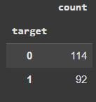
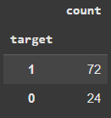

Portfolio
Home
About
Content
Others
Data Analysis: By Gender Analysis
# get male heart disease data
male_disease = df[df['sex']==1]['target'].value_counts()
male_disease
# get male percentage have positive heart disease
male_disease[1]/male_disease.sum()
# get female heart disease data
male_disease = df[df['sex']==0]['target'].value_counts()
male_disease
# get femalepercentage have positive heart disease
male_disease[1]/male_disease.sum()

Slide 13
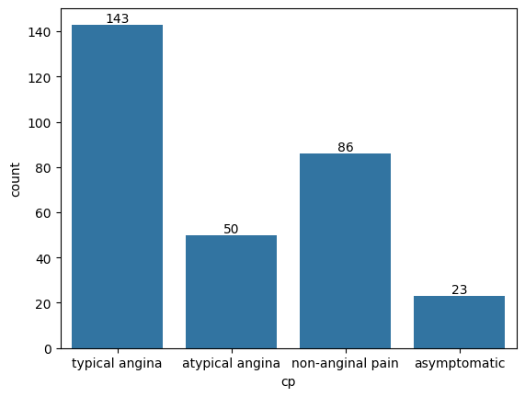
Portfolio
Home
About
Content
Others
Data Analysis: Patient Distributions by Type of Chest Pain
cp_bar = sns.countplot(x='cp', data=df)
cp_bar.set_xticklabels(['typical angina', 'atypical angina', 'non-anginal pain', 'asymptomatic'])
cp_bar.bar_label(cp_bar.containers[0])
Interpratation:
Based on the bar chart beside, it can be seen that the most frequently reported chest pain amongst patients is typical angula, while asymptomatic is the least frequently reported.

Slide 14
Portfolio
Home
About
Content
Others
Detecting Outliers
# Creating outliers detector function
def find_outliers_IQR(df):
q1=df.quantile(0.25)
q3=df.quantile(0.75)
IQR=q3-q1
outliers = df[((df<(q1-1.5*IQR)) | (df>(q3+1.5*IQR)))]
return outliers

Slide 15
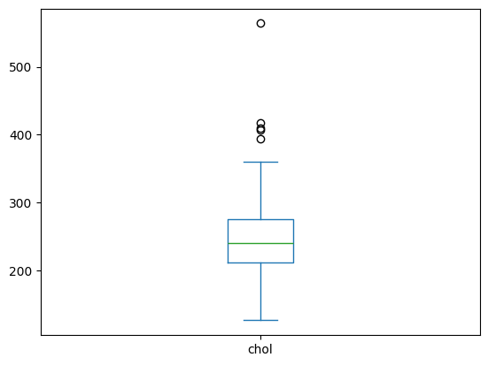
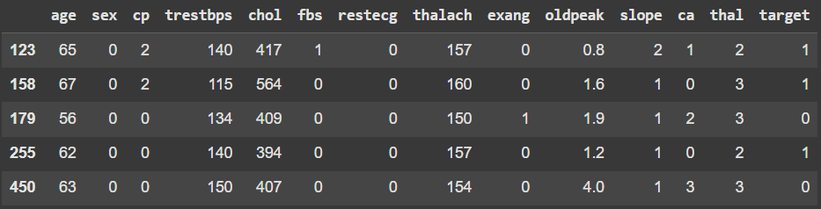
Portfolio
Home
About
Content
Others
Detecting Outliers: Cholestrol
chol_outliers = find_outliers_IQR(df['chol'])
df[df['chol'].isin(chol_outliers)]
df['chol'].plot(kind='box')

Slide 16
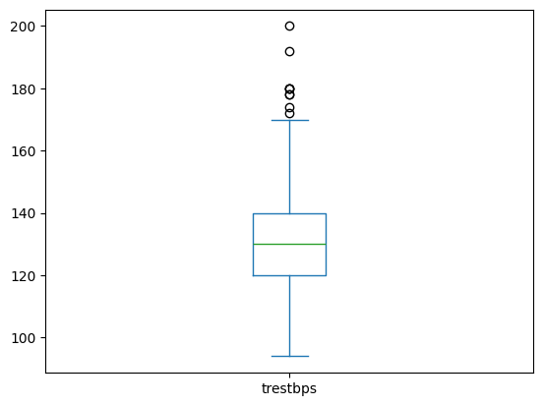
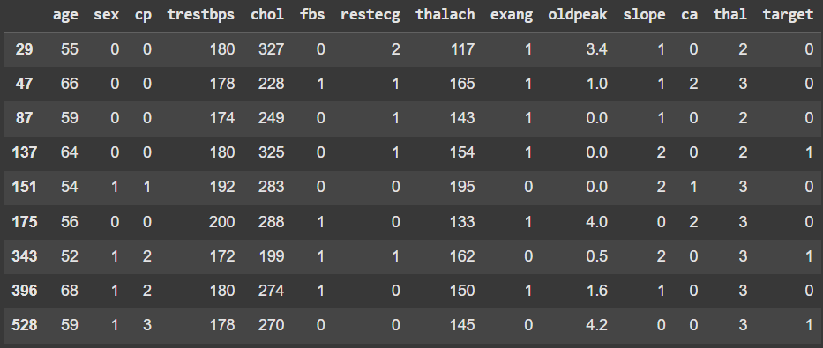
Portfolio
Home
About
Content
Others
Detecting Outliers: Resting Blood Pressure
trestbps_outliers = find_outliers_IQR(df['trestbps'])
df[df['trestbps'].isin(trestbps_outliers)]
df['trestbps'].plot(kind='box')

Slide 17
Portfolio
Home
About
Content
Others
Models List
Models and Evaluation
K Nearest Neighbor
Decision Tree
XGboost
Logistic Regression
Evaluation:
F1-Score, Accuracy, Confusion Matrix

Slide 18
Portfolio
Home
About
Content
Others
Data Splitting
80%
20%
Training Data
Testing Data

Slide 19

Portfolio
Home
About
Content
Others
K Nearest Neighbor
knn = KNeighborsClassifier(n_neighbors=3)
knn.fit(x_train, y_train)
y_train_predict_knn = knn.predict(x_train)
y_test_predict_knn = knn.predict(x_test)
classification_report(y_train, y_pred_train)
f1_score(y_train, y_pred_train)
classification_report(y_test, y_pred_test)
f1_score(y_test, y_pred_test)
Training Data
Testing Data
Support
(Data len)
241
Support
(Data len)
61
Accuracy
0.89
Accuracy
0.75
Macro Avg
0.89
Macro Avg
0.75
Weighted Avg
0.89
Weighted Avg
0.75
F1-Score
0.888
F1-Score
0.754

Slide 20
Portfolio
Home
About
Content
Others
Decision Tree
dtc = DecisionTreeClassifier()
dtc.fit(x_train, y_train)
y_train_predict_dtc = dtc.predict(x_train)
y_test_predict_dtc = dtc.predict(x_test)
classification_report(y_train, y_pred_train)
f1_score(y_train, y_pred_train)
classification_report(y_test, y_pred_test)
f1_score(y_test, y_pred_test)
Training Data (Overfit)
Testing Data
Support
(Data len)
241
Support
(Data len)
61
Accuracy
1.0
Accuracy
0.75
Macro Avg
1.0
Macro Avg
0.75
Weighted Avg
1.0
Weighted Avg
0.75
F1-Score
1.00
F1-Score
0.737

Slide 21
Portfolio
Home
About
Content
Others
XGBoost
xgboost = GradientBoostingClassifier()
xgboost.fit(X_train, y_train)
y_pred_train = xgboost.predict(X_train)
y_pred_test = xgboost.predict(X_test)
classification_report(y_train, y_pred_train)
f1_score(y_train, y_pred_train)
classification_report(y_test, y_pred_test)
f1_score(y_test, y_pred_test)
Training Data (Overfit)
Testing Data
Support
(Data len)
241
Support
(Data len)
61
Accuracy
1.0
Accuracy
0.80
Macro Avg
1.0
Macro Avg
0.80
Weighted Avg
1.0
Weighted Avg
0.80
F1-Score
1.00
F1-Score
0.806

Slide 22
Portfolio
Home
About
Content
Others
Logistic Regression
logreg = LogisticRegression()
logreg.fit(X_train, y_train)
y_pred_train = logreg.predict(X_train)
y_pred_test = logreg.predict(X_test)
classification_report(y_train, y_pred_train)
f1_score(y_train, y_pred_train)
classification_report(y_test, y_pred_test)
f1_score(y_test, y_pred_test)
Training Data
Testing Data
Support
(Data len)
241
Support
(Data len)
61
Accuracy
0.86
Accuracy
0.77
Macro Avg
0.86
Macro Avg
0.77
Weighted Avg
0.86
Weighted Avg
0.77
F1-Score
0.882
F1-Score
0.787

Slide 23
Portfolio
Home
About
Content
Others
Best Training -Testing Models
Training
Considering the overfitting in the training models of both Decision Tree and XGBoost, it can be concluded that the best model is Logistic Regression, with F1-scores of 0.882 for the training model and 0.787 for the testing model. This indicates that the Logistic Regression model can correctly classify 'heart disease' with 78% accuracy on the testing data, which is the highest performance among all the models evaluated.
K Nearest Neighbor
0.888
Testing
XGBoost
0.806
Conclusions
The best model
Logistic Regression
Training: 0.882
Testing: 0.787

Slide 24
Portfolio
Home
About
Content
Others
Thank You
Bhima Fairul Rifqi
fairulrifqi962@gmail.com
https://www.linkedin.com/in/fairulrifqi962
Hendri Agustono
h1091221058@student.untan.ac.id
https://www.linkedin.com/in/hendri-agustono
-

